Slide 1
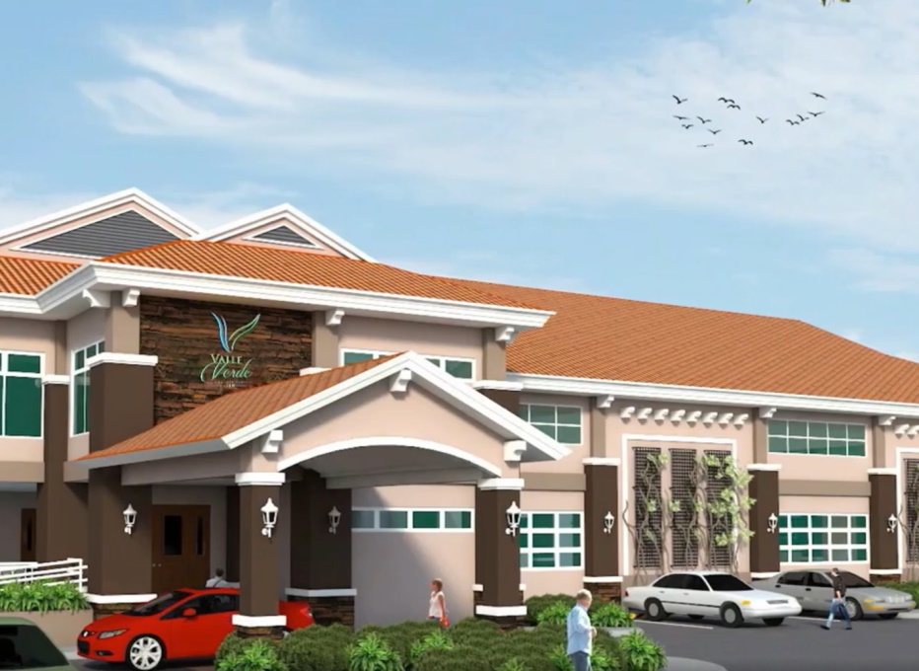
Live in a serene private haven hidden in the busy streets of Mactan City. Valle Verde Residential Estates is an exclusive sanctuary perfect for those who want to enjoy both seaside living and a luxurious lifestyle. Enjoy the panoramic view of Marcelo-Fernan Bridge as well as the premium amenities that will help you keep a well-balanced lifestyle.
FEATURES AND AMENITIES:
Multi-purpose clubhouse with:
Tennis court
Basketball court
Swimming pool
Concrete curbs and gutters
Landscaped entrance gate
Centralized interrelated water system
Complete electrical facilities

